Slide 1
Y6: Parklands Primary Academy
6L and 6C

Slide 2
What Year Six is all about…
Promoting self-belief, aspiration, determination & independence
Role models for the rest of the school.
Securing the best skills possible for secondary school
Being emotionally ready for the next step in education
The residential & the prom!
Having a fantastic, final year at Parklands Primary

Slide 3
A standard day in Y6….

Slide 4
P.E - Tuesday
P.E will be inside and outside within the week depending on weather/hall availability, so whilst the weather is mild, shorts and t-shirt please, and have it in school all week.

Slide 5
Our Curriculum
Our creative curriculum topic this term is The Mysterious Maya
Our curriculum provides exciting opportunities to learn through experiences rather than written evidence.
Encourages an independence in learning
Helps to develop an awareness of the world around them, and their place within it
Ensures that key skills are learned within an interesting, relevant context

Slide 6
English and maths
- Groupings are very flexible, and all pupils will cover all Year 6 elements.
- SATs – May 11th-14^{th, 2020 -} we will have an information meeting before then to give more details
Homework: Sent home on a Friday – Due in on a Wednesday please.
A grammar/comprehension challenge
A maths challenge from their set
Spelling investigation
Reading for pleasure

Slide 7
How can I help my child?
Encourage all types of reading and discuss their understanding with them, filling in their reading journals.
SPaG – correct them if their grammar is incorrect (spoken and written)
Encourage them to get involved in real maths:
How much is the basket of shopping?
What change will they receive?
Measure things out on a scale and convert to an equivalent measure
Look at timetables and plan a journey
Support them with their times tables (TTRockstars)
Encourage them to use their revision guides

Slide 8
Residential
Pioneer Centre in Kidderminster - 1st-3rd, July, 2020
A great opportunity for the children to become more independent and organised whilst having fun with their friends

Slide 9
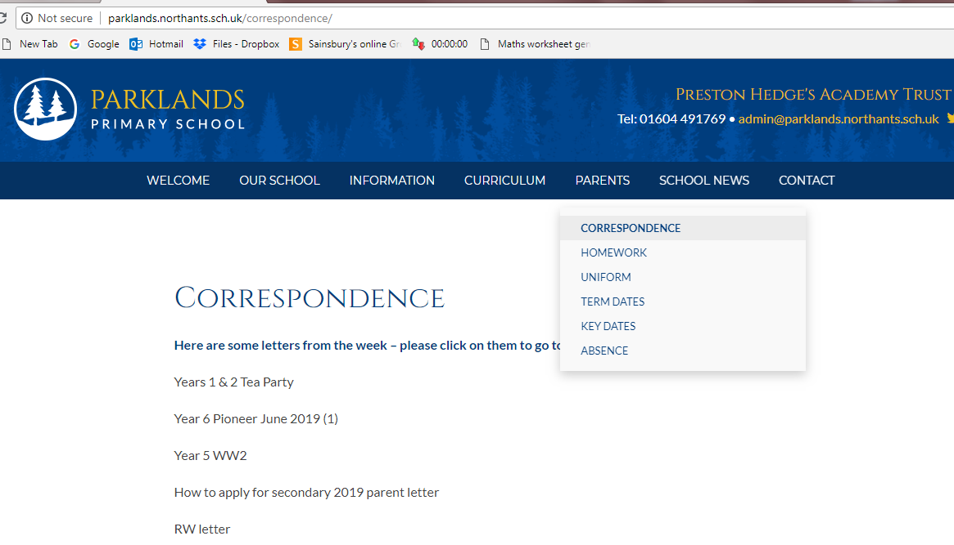
Correspondence

Slide 10
Other information:
Parent mail will not be used after September.
If you have not yet set up parent pay see the office.
We now have a fabulous new lunch time provider – Grow

Slide 11
But most importantly…
If you have any questions or queries, please pop in to see us at any time – our doors are always open and you are welcome to have a chat.
Thankyou.

