Slide 1
KS2 Calculations Parent Meeting

Slide 2
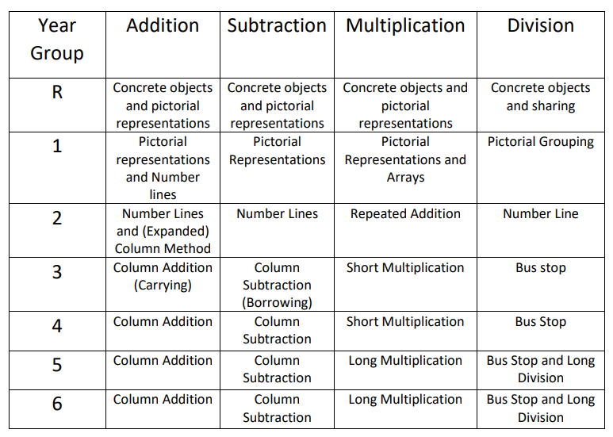
General Methods
Proud to be part of

Slide 3
Addition
Formal column method
Children start off with no carrying and then move onto numbers involving carries:
789 + 642 =
Formal column method involving decimals
(children move onto more challenging numbers involving decimals with different numbers of digits):
4478.158 + 356.35 =
Proud to be part of

Slide 4
Subtraction
Decomposition column method
children start off with no borrowing and then move onto calculations involving borrows
932 – 457 =
Formal column method involving decimals
children move onto numbers with decimals with varying digits
491.7 – 56.931 =
Proud to be part of

Slide 5
Multiplication
Short formal method
761 x 6 =
Long formal method
124 x 35 =
Long formal method involving decimals
4.56 x 5.2 =
Proud to be part of

Slide 6
Division
Bus stop method
495 ÷ 5 =
Bus stop with remainders
728 ÷ 6 =
Long division
425 ÷ 17 =
Proud to be part of

Slide 7
Fractions
Year 3​ | Year 4​ | Year 5​ | Year 6​
Find fractions of an amount (practically, pictorially, written method and inverse). ​ ​ Show, using diagrams, equivalent fractions.​ ​ +/- fractions with the same denominators (with answers less than a whole).​ ​ Compare/order fractions with the same denominator.​ | To recognise and show equivalent fractions.​ ​ +/- fractions with the same denominator (going over a whole).​ ​ Convert mixed numbers to improper fractions and vice versa.​ ​ Solve problems involving fractions. ​ ​ | To identify, name and write equivalent fractions +/- fractions with different denominators (including mixed numbers).​ ​ Compare/order fractions with different denominators.​ ​​ Write all fractions bigger than one as a mixed number.​ ​ Multiply fractions​ (proper fractions and mixed numbers by whole numbers) | To find fractions of number To use common factors to simplify fractions.​ ​ +/- fractions with different denominators (including mixed numbers). Compare/order fractions, including fractions > 1.​ ​ Multiply fractions (simple pairs of proper fractions Divide fractions.​ ​
Proud to be part of

Slide 8
Improper Fractions
We encourage children to turn all improper fractions into mixed numbers once taught in Year 4!
Proud to be part of

Slide 9
Adding Fractions
Mixed numbers need to be turned into improper fractions first!
Find a Common Denominator
Numerator + Numerator
Denominator stays the same
$$\frac{2}{6}+\frac{3}{4}=$$
Proud to be part of

Slide 10
Subtracting Fractions
Mixed numbers need to be turned into improper fractions first!
Find a Common Denominator
Numerator - Numerator
Denominator stays the same
$$\frac{4}{5}− \frac{1}{2}=$$
Proud to be part of

Slide 11
Multiplying Fractions
Whole number over 1
Numerator x Numerator
Denominator x Denominator
Mixed numbers need to be turned into improper fractions first!
$$\frac{2}{6}x 4=$$
Proud to be part of

Slide 12
Dividing Fractions
Keep it – keep first fraction the same
Flip it – flip the second fraction
Change it – change to multiplication
Mixed numbers need to be turned into improper fractions first!
$$1\frac{2}{6}÷\frac{3}{4}=$$
Proud to be part of

Slide 13
Any questions?
Proud to be part of

