Slide 1
SPaG Parent Meeting

Slide 2
How?
Clear SPAG focused slot – distinct from English
5 x a week sessions
Mental Maths style: teaching an area interactive whiteboard work test style question reinforcing skills needed succeed
Proud to be part of

Slide 3
Teaching the SPaG session….
Choose an element from the year group’s SPaG curriculum
Explain the terms & demo on the board for pupils, using top tips to help them remember
Interactive whiteboard session, applying the SPaG element in sentences/choosing the correct version etc
Applying it then to test-style questions to consolidate learning
Can all take place in one session if simple or run into two/more if more complicated
Proud to be part of

Slide 4
Example
SPaG topic: Active/Passive verb (needs previous understanding of subject & object in a sentence)
Top Tip :Active: subject verb object
Passive: object verb subject (often has ‘by ’ in it)
Teacher explains and demonstrates both styles
The dog ate the bone.
The bone was eaten by the dog.
Interactive element – picking out whether a sentence is active passive using top tips to see
Test style questions (identifying/changing an active sentence into passive & vice versa) with teacher giving advice on how to approach this (test skills)
Chance for them to try in pairs/independently
Proud to be part of

Slide 5
Tick one box in each row to show whether the sentence is written in the active voice or the passive voice.
Sentence | Active | Passive
Otters live in clean rivers.
Fish are eaten by otters.
Usually, otters are playful creatures.
Rewrite the sentence below in its passive form.
The visitor gave a speech.
Remember to punctuate your answer correctly.
____________________________________________________________
1 mark
Proud to be part of

Slide 6
Proud to be part of

Slide 7
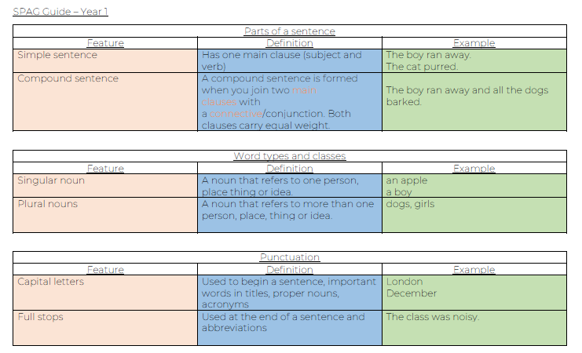
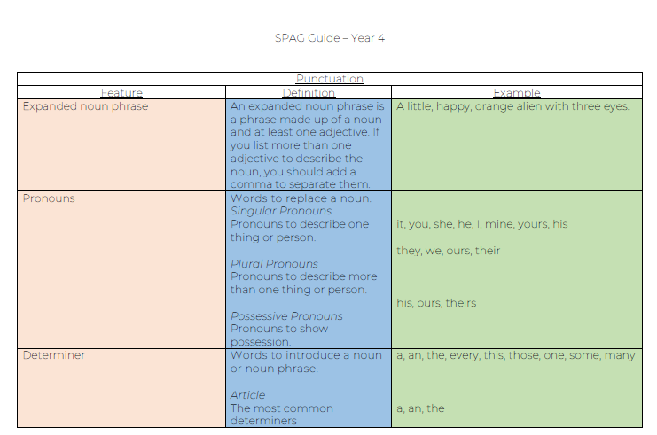
Proud to be part of

Slide 8
Spellings
Fortnightly investigatory spelling curriculum in KS2
Statutory/common exception words
Why the focus? As we improve on SPaG, spelling is a key area.
Proud to be part of

Slide 9
Investigations:
Investigation = spelling patterns, their rules & exceptions rather than discrete spellings
The aim is to give children skills that they can use based on their knowledge & understanding of how spellings work, in order to successfully spell an unknown word.
Proud to be part of

Slide 10
Eg. ‘shun’ sound:
NEVER made by ‘shun’ except in the word shun/shunned/shunning….
The actual true suffixes are -ion or -ian . The clues about whether to put t, s, ss or c before comes from the last letter(s) of the root word:
-tion is the most common spelling. It is used if the root word ends in t (invent) or te (hesitate)
-ssion is used if the root word ends in –ss or –mit (omit- omission/ possess – possession)
-sion is used if the root word ends in d or se (comprehend – comprehension/ tense - tension
Exceptions: attend – attention, intend – intention, nation
-cian is used if the root word ends in c or cs (music- musician, politics - politician
Proud to be part of

Slide 11
Process
Spelling follows a 2 week cycle: ​
In Week 1 we introduce the spelling investigation, showing the children which sound we will be focussing on. During the investigation, children will explore the letter combinations that create the sound as well as words that can be formed from that combination of letters. For example: Our sound “oo”
Letter combinations that create this sound ew ue
Words that can be created using these letter combinations few new knew
At the end of the cycle, the children will sit a spelling test.
​
Proud to be part of

Slide 12
Method of teaching:
Really interactive (like SPaG)
Intro the sound & the patterns that make it (with their rules)
Get the children to explore words that use the sound
Try out the spellings using the rules
Proud to be part of

Slide 13
Method of homework
Not how many words they can find – a continuation of the investigation
Try out first… look to check later
Can be only a few words – it’s about applying the rule
Proud to be part of

