Slide 1
Welcome to Year 4. Let’s meet the team!

Slide 2
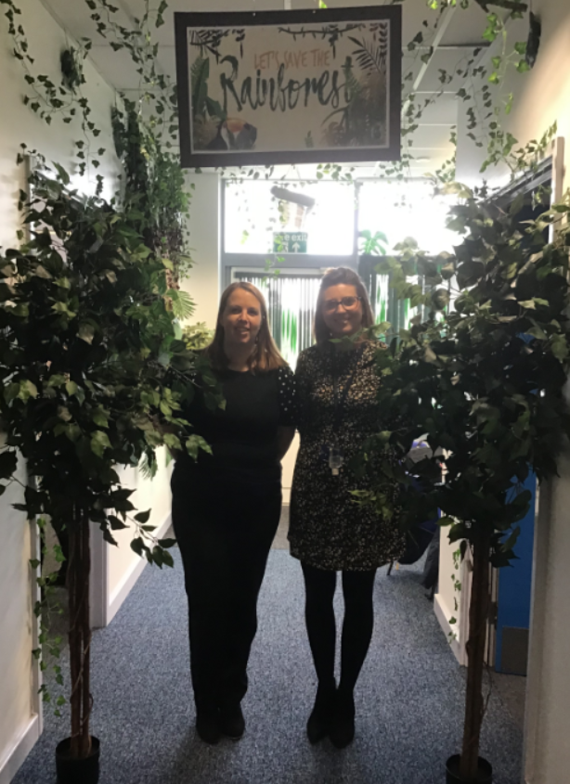
4 W – Mrs Wright
4R – Mrs Rees
Phase 2 Leader(Year 3 and 4) – Mrs Rees

Slide 3
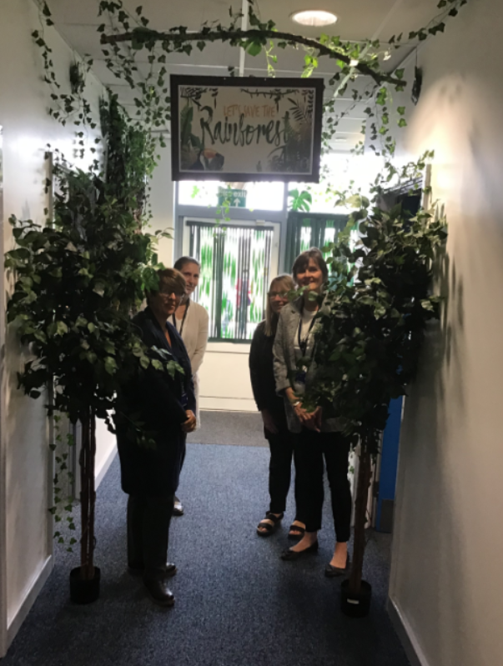
Our support team for the year is:
Mrs Wheal
Mrs Wilkinson
Mrs Graham
Mrs Farmer will be providing PPA
cover across the year group.

Slide 4
Outline of our day.
TT Rockstars – Multiplication tables practise.
Maths (sets for Maths)
Assembly in classroom via video presentation.
Break
English
SPAG and Handwriting
Lunch
Creative Curriculum
Classic Read.
* Reading for Pleasure – half hour session (Friday)

Slide 5
Creative Curriculum
During the afternoon we will be delivering a wide and balanced curriculum.
Our theme for term 1 is Climate Change and we will link the other areas of the curriculum to this theme.
PE will be every Tuesday, so please come dressed in school PE kit for this day only.

Slide 6
Other elements
The children will be receiving 5 x 15 mins sessions of handwriting.
Timetables – Everyday in preparation for the Year 4 compulsory times table test in June 2021.
Weekly comprehension and arithmetic lesson
Celebration assembly will continue every Friday for the children to bring in anything they are proud of.
Reading for pleasure books from the library will be issued every fortnight.

Slide 7
Homework
Friday is homework day.
Each week the children will receive Grammar and Maths work based on the teaching of that week.
Spellings will be tested on a Friday - every third week.
Week one – investigation of spelling pattern.
Week two - continue to investigate the spelling pattern.
Week three - Test 5 familiar words and 5 unknown words following the pattern.
Reading regularly at home – Children to fill in Reading journal.
TT Rocks Stars. – times tables practice.
Please make sure reading and spelling journals are in school every day.

Slide 8
Other info:
We are very limited in space in the classrooms, please can children bring book bags and not large rucksacks.
We now have our lunch time provider – ‘Grow’ If your child would like to have hot lunches.

Slide 9
Finally!
Please feel free to come and talk to us about you child.
We are looking forward to a success and creative year!
The Year 4 Team

