Slide 1
Welcome to Year 2!
Miss. Thompson and Miss. Malpas
Mrs Kennedy, Mrs Corrigan, Mrs Graham, Mrs Wilkinson, Miss Cross

Slide 2
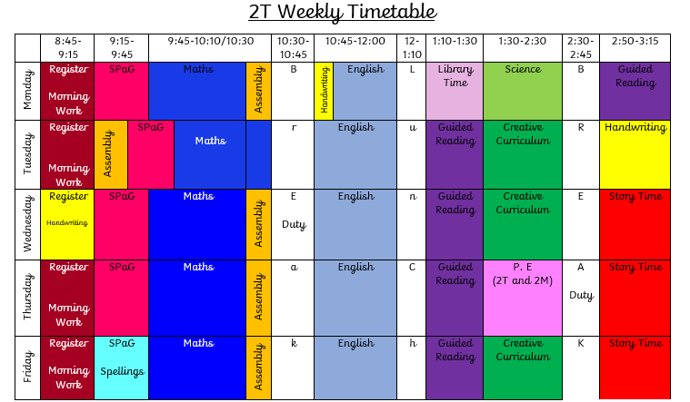
The Timetable

Slide 3
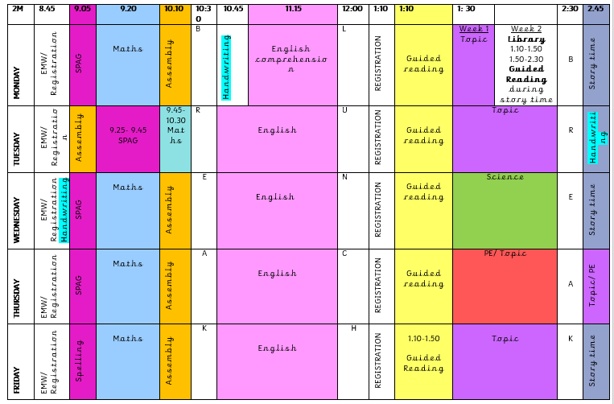
2M Weekly Timetable

Slide 4
Reading
Daily Readers- every child is read with every week either by the class teacher or teaching assistant.
Book change- for all year 2 children book change will be on a Monday and a Thursday. Books will only be changed if it has been read at home.
Children are encouraged in year 2 to re-read stories so that they can: answer and ask questions, retell the story, predict what might happen and participate in discussions about the book.
Daily Guided Readings sessions for 30 minutes and a weekly comprehension.
Fortnightly library sessions.

Slide 5
Handwriting
A new style of handwriting across the school.
Pre- cursive handwriting.
3 sessions a week.
- practical activities e.g. writing in the air
- practising on whiteboards
- applying the skills to handwriting books.

Slide 6
English
Daily English sessions with Monday focussing on comprehension.
The routine-
Analysing texts
Shared writes
Have a go independent writes
Big write

Slide 7
Homework and spellings
All homework and letters/ information are given out on a Friday.
One week SPaG based. One week Maths based.
Homework is to be returned the following Wednesday.
Weekly spellings- a week to practise and a quiz the following Friday.

Slide 8
PE Timetable
Both classes have PE on a Thursday PM.
Outdoor PE will change each week depending on the topic (we have the freedom to go out as and when we wish!). Please ensure outdoor kits are in every day because of this.

Slide 9
The Creative Curriculum
FUN, CREATIVITY & ACHIEVEMENT
Immersive experiences designed to engage and excite the children
Discreet foundation lessons
Topic 1- Wonderland
(Pictures of displays, paintings)

Slide 10
Year 2 SATs
Year 2 SATs will take place during Summer 1 (May 2019).
- 1 x SPAG
- 1 x maths arithmetic
- 1x maths reasoning
- 2x reading
Please don’t be alarmed!
An information meeting will take place nearer the time.

Slide 11
We are always here if you have any questions/ need anything, you don’t need to wait until parents evening for this.
We are looking forward to working together and starting an exciting year ahead!

Slide 12
Any Questions?

